Slide 1
THE TAILOR-MADE AND ADVENTURE TRAVEL SPECIALIST
First semester results presentation
to 30 June 2020

Slide 2
ABOUT
Our main business lines | Individual tailor-made and adventure travel
Number of main brands | 17
Main brands | Voyageurs du Monde, Comptoir des Voyages, Terres d’Aventure, Nomade Aventure, Allibert Trekking, Uniktour (Canada), Original Travel and KE Adventure Travel (UK)
Accommodation | Satyagraha Guest House, Villa Nomade, Villa Bahia, Steam Ship Sudan and La Flâneuse du Nil
Number of employees | 1,395 employees including 362 outside France
Sales outlets | 38 including 3 in Canada, 1 in Belgium, 1 in Switzerland and 3 in the UK
Websites | 21 (over 1 million unique visitors per month)
Promoting sustainable tourism | Management of reforestation projects and financing development aid projects in certain countries.
Voyageurs du Monde • First semester 2020 results • 2

Slide 3
HIGHLIGHTS
2020: a year marked by Covid-19
Activity extremely hard hit by Covid-19
a normal first quarter (1 January to 15 March)
no departures or sales in the second quarter (lockdown and borders closed)
leading the Group to take the following measures:
Revenues: Protecting bookings
Trips postponed from mid-March to mid-September thanks to a government ordinance
Introduction of a special COVID travel insurance scheme to facilitate new bookings
Cash flow:
A credit note valid for 18 months for amounts paid instead of a refund.
Use of all options for delaying tax and social security payments
2019 dividend cancelled
€30 million government-guaranteed PGE loan obtained
Risk:
Obtaining refunds from airlines for cancelled flights (to date, 73% of refunds received, remainder as credit notes from airlines)
Regular contact with our agents in the destinations to insure the will go on with their activities.
Voyageurs du Monde • First semester 2020 results • 3
Notes:
3

Slide 4
HIGHLIGHTS
2020: a year marked by Covid-19
Staff:
All employees have been working from home since 17 March 2020
A furlough scheme was introduced gradually and at different levels depending on the team: between 50% of activity in March and April and 30% on average in June, then 15-20% at present.
Budgets:
Salaries reduction: stop all new recruitments, short term contracts, 100% furlough scheme 100 % covered by government (tourism, restaurants, events).
Exemption from employer charges on the part worked following a government decision from February to May (apart from Voyageurs du Monde > 250 employees)
Freeze on investment (IT, new offices, acquisition plans)
Negotiation of office leases (- €0.5m obtained, equivalent to 10% of total lease), professional liability insurance and miscellaneous contracts
Reduction in all other costs (communications, general expenses etc.)
Voyageurs du Monde • First semester 2020 results • 4
Notes:
4

Slide 5
ACTIVITY
Sales by activity
Activity | Main brands | S1.20 sales in €m (reported) | Change S1.20/S1.19 | % S1.20 sales
Tailor-made travel | Voyageurs du Monde, Comptoir des Voyages, Voyageurs au Canada, Original Travel | 45.2 | -56.0% | 60.0%
Adventure travel | Allibert Trekking, Terres d’Aventure, Nomade Aventure, Chamina Voyages, KE Adventure | 27.3 | -59.6% | 36.2%
Group and corporate travel | Voyageurs du Monde | 2.2 | -78.2% | 2.9%
Miscellaneous | Books, accessories, flights only etc. | 0.7 | -64.2% | 0.9%
Total |  | 75.4 | -58.6% | 100%
Voyageurs du Monde • First semester 2020 results • 5
Voyageurs du Monde • First semester 2020 results • 6

Slide 6
RESULTS
First semester income statement (reported)
Figures in €m | S1.2020 | S1.2019 | Change | 2019
Sales | 75.4 | 182.2 | -58.6% | 487.5
Gross profit % of sales | 24.3 32.3% | 54.7 30.1% | -55.6% | 143.6 29.5%
Operating expenses | 36.7 | 58.3 | -36.9% | 116.1
EBITDA* | (9.9) | (1.3) |  | 33.6
EBIT** | (12.2) | (3.4) |  | 29.1
Tax | 3.1 | 0.6 |  | (8.8)
Net income before goodwill | (9.2) | (2.9) |  | 20.5
Minority interests | (0.0) | 0.2 |  | (0.3)
Net income | (9.2) | (2.7) |  | 20.3
* Earnings Before Interest, Taxes, Depreciation and Amortization
**Earnings Before Interest and Taxes
Voyageurs du Monde • First semester 2020 results • 6
Voyageurs du Monde • First semester 2015 results • 8

Slide 7
RESULTS
First semester balance sheet (reported)
ASSETS in €m | S1.2020 | S1.2019
Fixed assets | 69.4 | 67.0
Inventories | 0.4 | 0.4
Advances and trade receivables | 70.3 | 111.5
Other receivables | 44.5 | 75.8
Cash and cash equivalents | 158.0 | 155.4
TOTAL | 342.6 | 410.1
EQUITY & LIABILITIES in €m | S1.2020 | S1.2019
Equity | 102.8 | 89.7
Provisions | 1.2 | 1.2
Financial liabilities | 38.6 | 9.9
Advances and trade payables o/w customer prepayments | 79.8 48.3 | 60.9 4.9
Deferred income* | 120.2 | 248.4
TOTAL | 342.6 | 410.1
30.06.20 30.06.19 Chg (%)
Deferred income 120.2 248.4 -51.6%
Voyageurs du Monde • First semester 2020 results • 7
Voyageurs du Monde • First semester 2015 results • 11

Slide 8
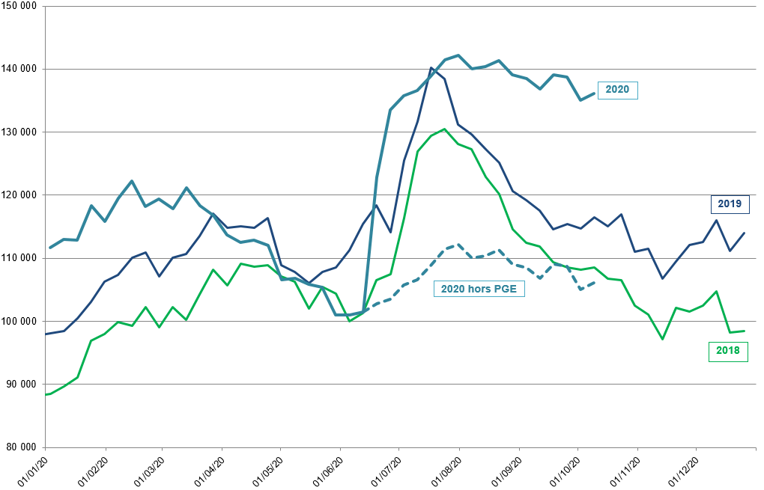
RESULTS
Cash flow charts
(5 main TOs in France and adventure travel holding company, in €’000)
Voyageurs du Monde • First semester 2020 results • 8

Slide 9
OUTLOOK
Situation in 2020:
1 / current estimated results
Cash flow chart
Figures in €m | 2020 estimate | 2019 reported | Chg
Sales | 119 | 487.5 | -75%
Gross profit % of sales | 36 30% | 143.6 29.5% | -75%
Operating expenses | 57 | 116.1 | -51%
EBITDA* | (17) | 33.6
EBIT** | (21) | 29.1
Net income | (14) | 20.3
* Earnings Before Interest, Taxes, Depreciation and Amortization
**Earnings Before Interest and Taxes
Voyageurs du Monde • First semester 2020 results • 9

Slide 10
OUTLOOK
Situation in 2020:
2/ financing the loss
Figures in €m
Equity (incl. minority interests) | 114.2
Net fixed assets | 68.9
Available equity as at 31/12/2019 (reported) | 45.3
2020 net fixed assets | 1.7
2020 estimated loss | (14)
Available equity as at 31/12/2020 (reported) | 33.0
Voyageurs du Monde • First semester 2020 results • 10

Slide 11
OUTLOOK
2021 forecast:
1/ 2020 trips postponed to 2021
Figures in €m | Sales
Booked departures as at 15/03/2020 | 270.6
1st semester departures | (75.4)
Departures that can be postponed as at 30/06/2020 | 195.2
New bookings | 19.4
2020 cancellations | (14.3)
2nd semester departures | (43.6)
Departures that can be postponed as at 31/12/2020 | 156.7
o/w already registered | 38.3
Still to be postponed | 118.4
Estimated 2020 sales
€119m
Target: postpone as much as possible the remaining €118m
Deferred income as at 31/12/2019 = €156.3m
Voyageurs du Monde • First semester 2020 results • 11

Slide 12
OUTLOOK
2021 forecast:
2/ Income statement based on 2 scenarios
Scenario 1: stop & go (calculation of breakeven)
Scenario 2: gradual opening up
Figures in €m | Breakeven 2021 | Gradual opening up of countries 2021 | 2019
Sales | 173.0 | 300.0 | 487.5
Gross profit % of sales | 51.9 30.0% | 90.0 30.0% | 143.6 29.5%
Operating expenses | 52.2 | 72.7 | 116.1
EBITDA | 4.4 * | 22.0 | 33.6
EBIT | (0.3) | 17.3 | 29.1
* The breakeven point calculated for EBITDA gives target sales of €158m, assuming the introduction of the long term furlough scheme without government aid.
Voyageurs du Monde • First semester 2020 results • 12

Slide 13
OUTLOOK
2021 forecast:
3/ Scenario of gradual opening up:
Potential development of new bookings
Sales: 2021 departures (€m)
2021 new bookings
2020 sales that can be postponed
Comparative monthly sales 2021 vs. 2019 (€m)
35%
45%
60%
70%
75%
90%
25%
80%
95%
15%
100%
100%
Voyageurs du Monde • First semester 2020 results • 13
Notes:
Can be postponed 2020

Slide 14
2021 forecast:
4/ Scenario of gradual opening up: overview of
destinations to date
OUTLOOK
Top 15
Top 16-30
United States | 6.7%
Japan | 4.4%
Italy | 4.3%
Tanzania | 4.1%
France | 3.9%
Egypt | 3.0%
South Africa | 2.6%
Canada | 2.5%
Greece | 2.4%
Namibia | 2.3%
Portugal | 2.2%
Iceland | 2.1%
Spain | 2.0%
Polynesia | 1.9%
Peru | 1.9%
TOTAL | 46.2%
Vietnam | 1.9%
Costa Rica | 1.9%
Indonesia | 1.7%
Jordan | 1.7%
Norway | 1.7%
Russia | 1.6%
India | 1.6%
Cuba | 1.5%
Thailand | 1.5%
Finland | 1.4%
Argentina | 1.3%
Morocco | 1.3%
Oman | 1.3%
Sri Lanka | 1.3%
Australia | 1.3%
TOTAL | 23.0%
Destination open
Destination open, entry restrictions
Destination closed
Top 15 destinations = €197m Next 15 countries = €98m
In 2019, 30 countries = 69.2% of sales and €295m of departures.
In total, 27 destinations open to date representing 34.8% of 2019 sales, or €148.5m.
In addition to the 10 open destinations listed above, there are: Seychelles, Mexico, Brazil, Croatia, Réunion Island, Ecuador, Mauritius, Montenegro, Sweden, Turkey, Senegal, Germany, Guadeloupe, Dominican Republic, Martinique, Saint Lucia and Panama.
Voyageurs du Monde • First semester 2020 results • 14

Slide 15
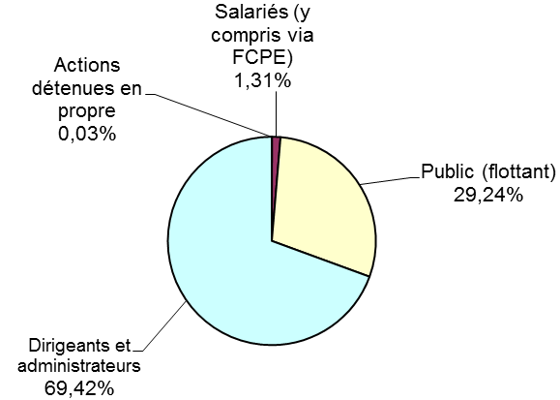
SHAREHOLDER INFORMATION
Share price performance
Share price as at 26 October 2019: €107.00
Share price as at 26 October 2020: €49.50
Shareholding structure as at 30 June 2020
Employees
(incl. via FCPE fund)
Treasury stock
Free float
Directors and board members
Voyageurs du Monde • First semester 2020 results • 15
Notes:
Employees (incl. via FCPE fund)
Free float
Directors and board members
Treasury stock

